Slide 1



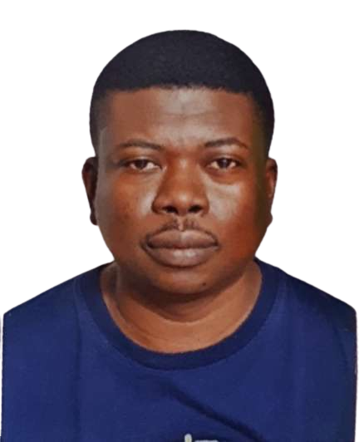



IntelliSense
Optimal Environmental Quality
GROUP 3
Kuiyu Ding
Shola Olayemi
Sudharshan A V
Bello Nuhu
Fahadh Mohamed

Slide 2

Project Objective
To detect environmental indices by collecting relevant parameters such as;
Environmental sound quality
Temperature and Humidity
Set different thresholds to determine how good the environmental indices are represented.

Slide 3

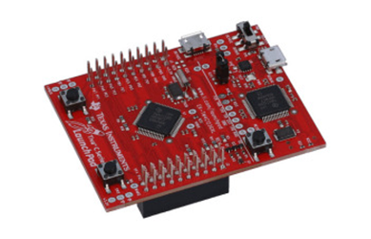


Project Implementation
Based on the project design, the electronics of the project were assembled and integrated around the microcontroller.
These included the following;
Hardware:
Tiva Microcontroller - ARM® Cortex®-M4F Based MCU TM4C123G Launchpad
Temperature and Humidity Sensor
Ultrasonic Sensor
Main board, display board and amplifier board
Software:
Energia IDE was used to program the microcontroller and in C language. It was also used to display the environmental parameters obtained by the sensors.

Slide 4
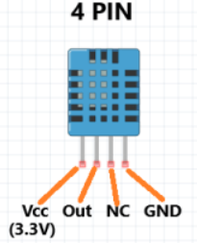
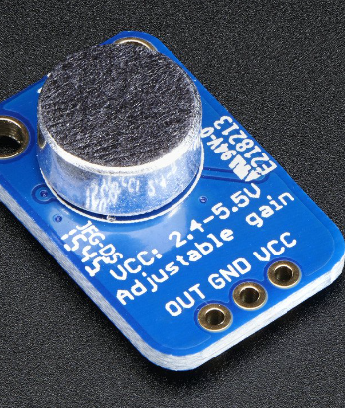
Sensors Integrated
•Temperature and Humidity Sensor - DHT11
•Ultrasonic Sensor – Electret microphone amplifier(MAX4466)

Slide 5
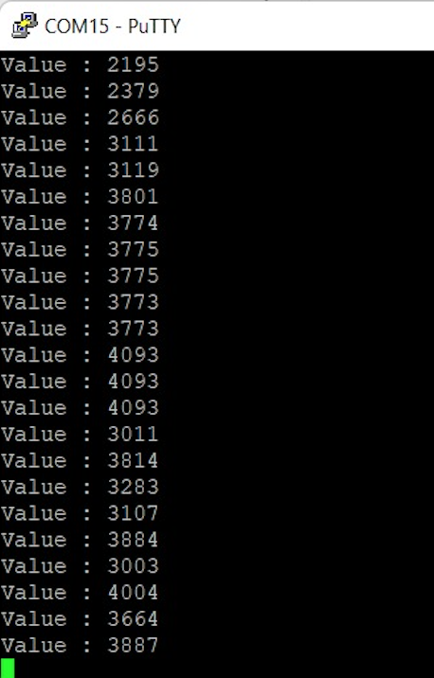
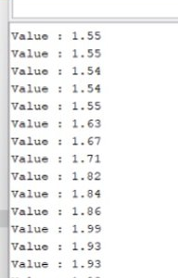
ADC and Voltage Values
via Putty
Microcontroller has a 12 bits ADC = 2¹² = 4096
VCC * ADC/4096

Slide 6
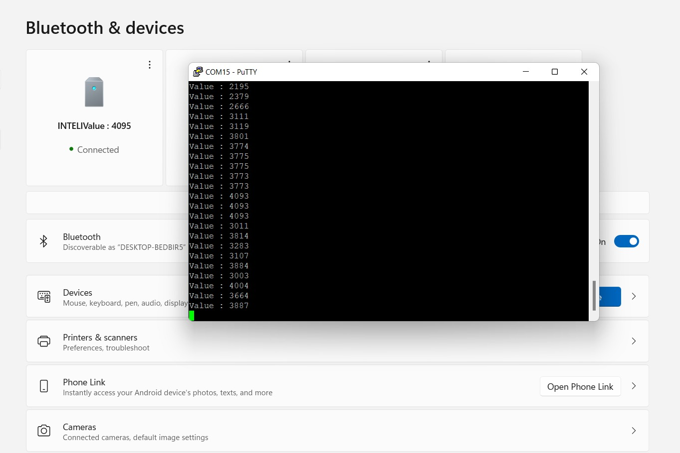
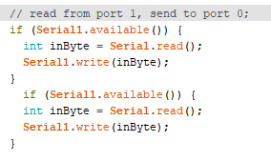
Display on PC via Bluetooth Connection

Slide 7
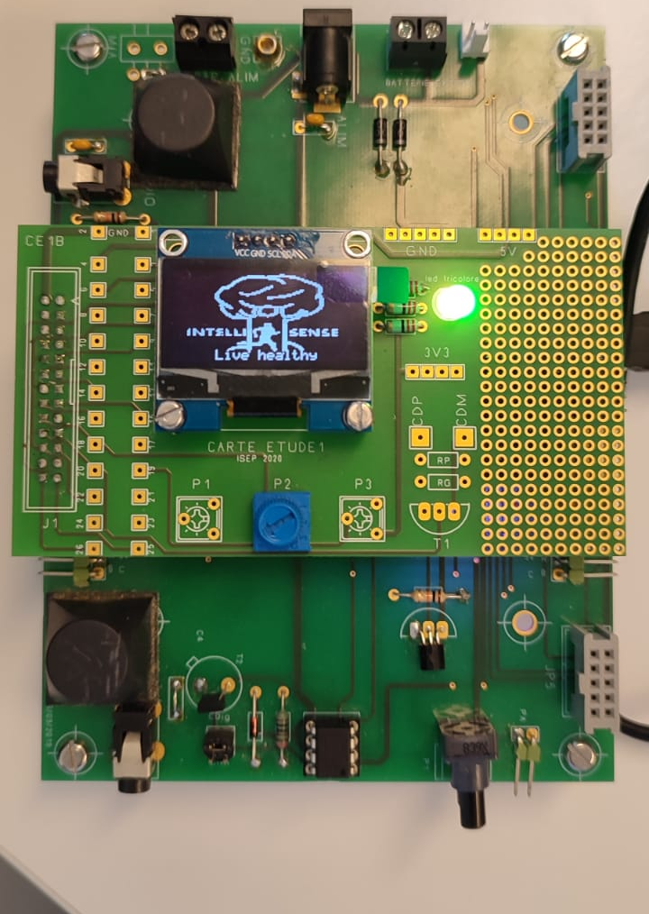
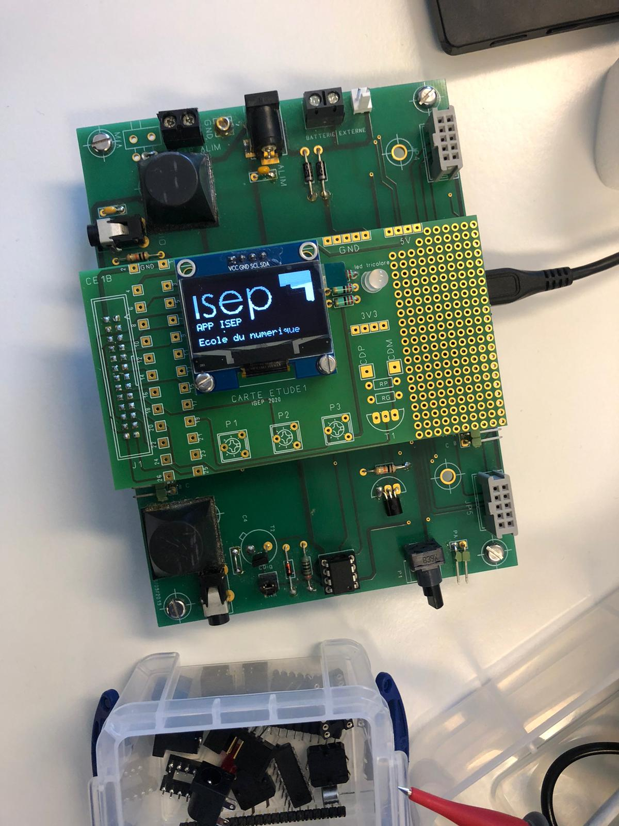
OLED DISPLAY
We uploaded image in a website to convert into hexadecimal code and we displayed our logo in lcd display through energia.

Slide 8
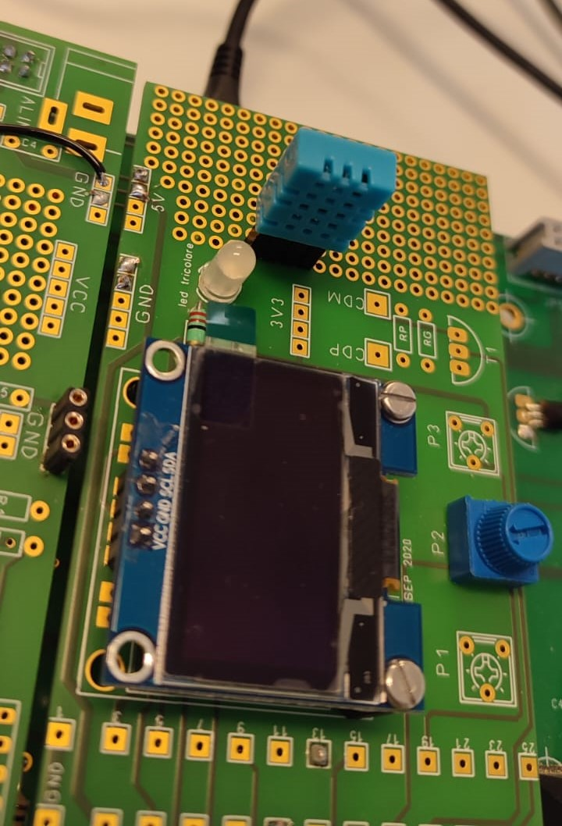
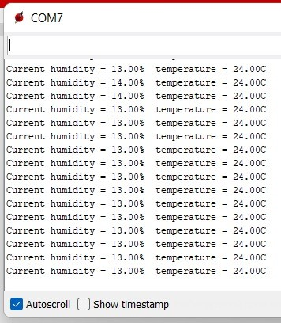
Temperature and humidity :
We connected temperature and humidity sensor to the extended board. The data shows the output of temperature and humidity sensor.
-4°C – -1°C: Bad
0°C – 6°C: Fair
7°C – 15°C: Ideal
16°C – 22°C: Fair
23°C – 30°C: Bad

Slide 9
System Operation
The device is triggered based on the power of an audio signal compared to the silence threshold.
It starts to listen for the key by passing the signal through a filter. If the key is detected by the filter, then the device begins measuring process.
It measures the sound quality in decibels
It measures and outputs the temperature and humidity of the environment.

Slide 10
Data Treatment
Fs sampling frequency imposed on microcontroller
Key not detected recompute power for another sample
S(t)
ADC
TRIGGER
Recording & Analyzing the Signal
Filter
S(ms)
S(mte)
Key detected
Estimates of different measures

Slide 11
Trigger System
Silence-Threshold
Discrete Signal
Wake Device
S(mts)
Establish Silence Level
Sample Signal (Fs/4)
Power
Computation
Is power greater than the silence threshold
Key detection process
Recompute the power for another sample

Slide 12
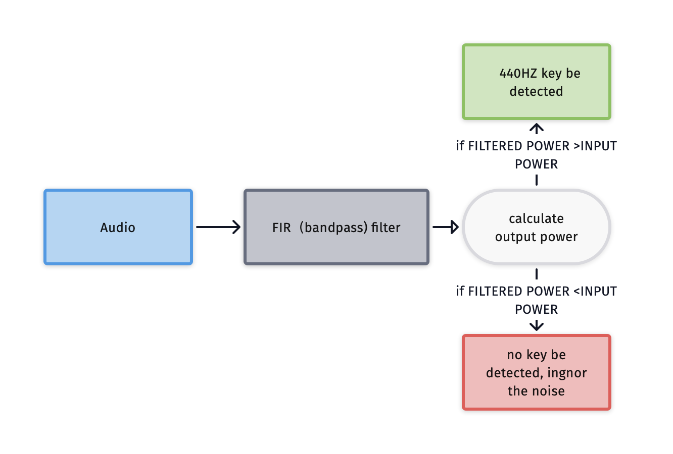
Filter design and implement
1.Design idea
Only 440HZ key "la" can pass
Key or nosie

Slide 13
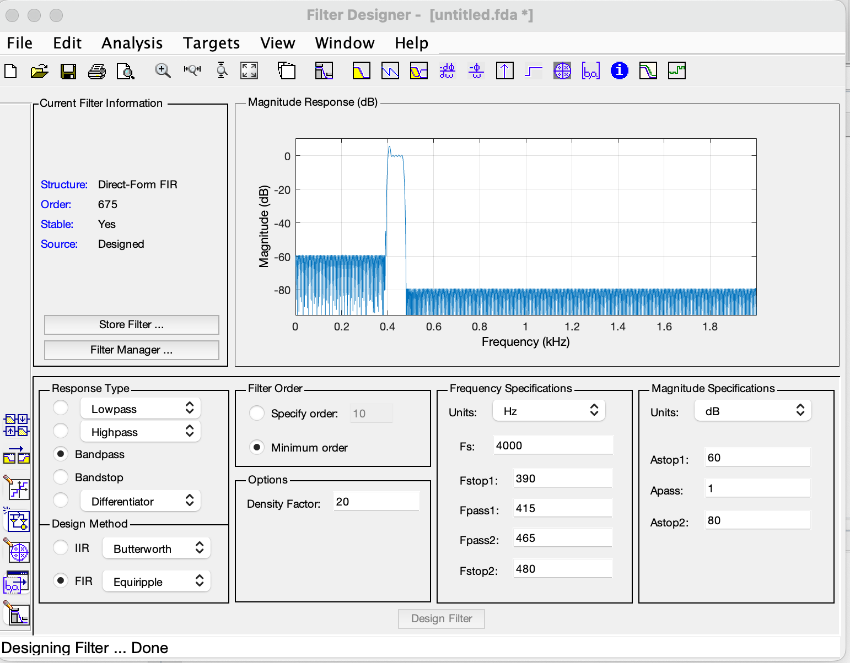
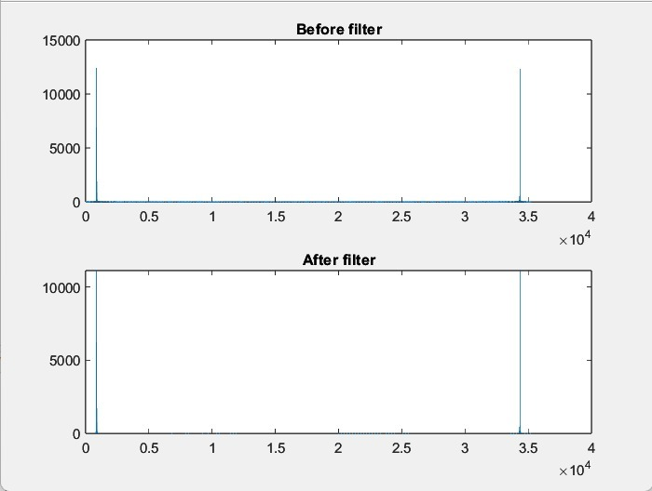
2.Matlab simulation
Filter Designeer tool
By using filterDesigner, filters can be easily designed in Matlab.
In this case , we need to choose these parameter when designing the filter:
Samplign frequency => 2B
Design method : FIR;
Response type: Bandpass
Other parameters..
Compare the response of the input signal and the output signal in the frequency domain.
Result means input signal could pass the filter.

Slide 14
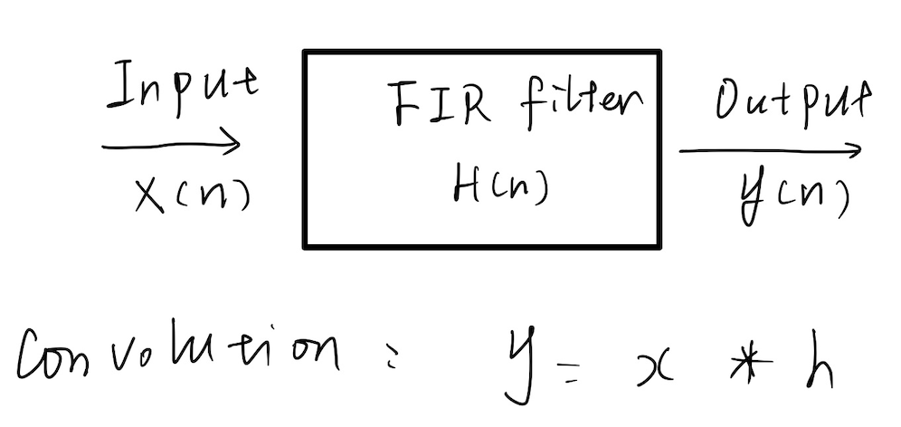

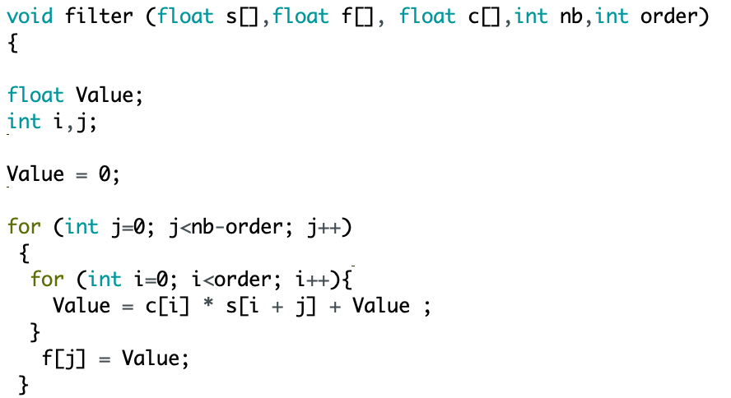

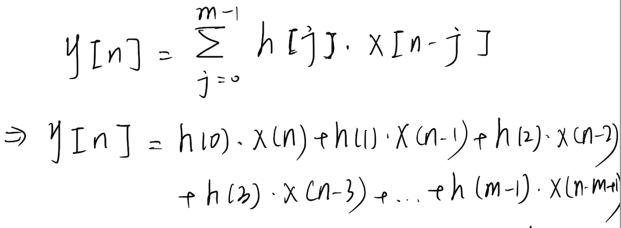
3. Principle of FIR filter and implementation
Convolution in time-domain = mutiplying in frequency-domain
Inplement the left formula on energia by c language
N: length of sample—NBSAMPLE 1000;
M: order of filter ---- number of coefficient;

Slide 15
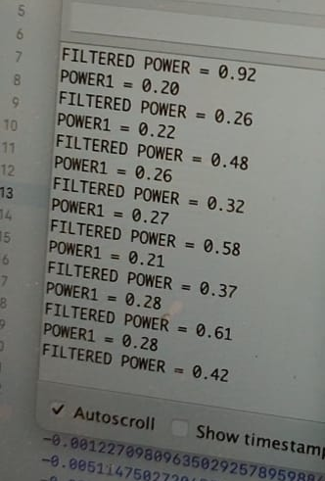
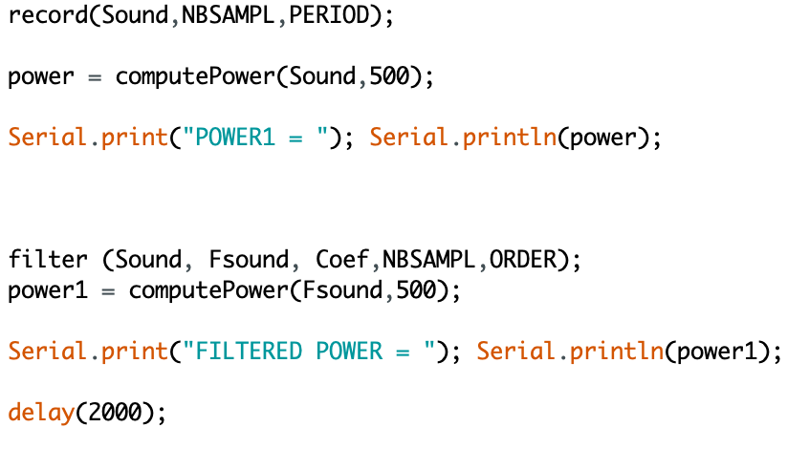
4.Calculate power
Envaluate if the key be detected by calculate the output power of the filter signal. Key is detected when power is more than power1

Slide 16

Energy Conservation
The product consumes 456mw of power
The product is expected to run for 13 hours a day.
Consequently, the power consumption is 6000mwh.
Therefore, energy consumed in 1 year = 6000 x 365 = 2,190,000mwh
i.e. 2.19Kwh
This equivalent to 0.0009 Metric Tons of CO2 = 1 pound of coal burned = 0.001 acres of US forest in 1 year.
To conserve the battery, we recommend a solar solution to charge the battery.

Slide 17
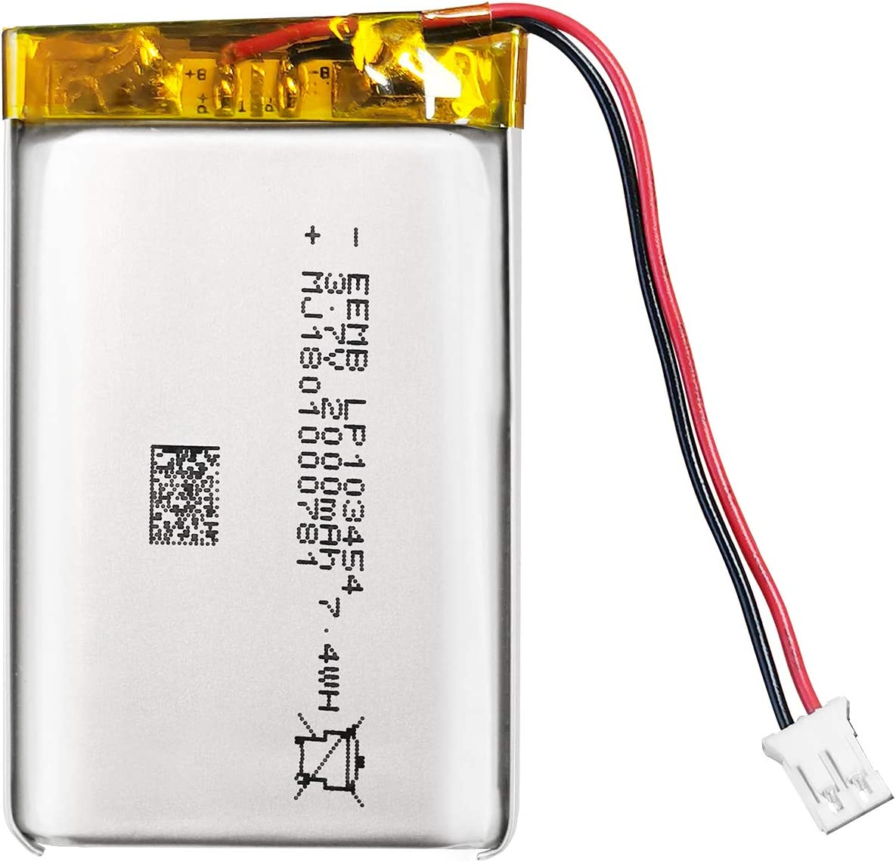
Power Consumption & Battery Autonomy
Battery Lithium-ION
EEMB 3.7V 2000mAh
103454
Battery Lithium-ION
Rechargeable with connector
Storage & Application
No leaks, excellent economic performance and long service life.
PCM protection function:
over charge, over discharge, over current, short circuit protection,
over temperature protection.
Keep cells in 40-60% state of charge during long-term storage.
Recommend charging the battery every 3 months
after receiving the battery and keeping the voltage 3.7-4.0V.
Notes:
No leaks, excellent economic performance and long service life. PCM protection function: over charge, over discharge, over current, short circuit protection, over temperature protection.
Keep cells in 40-60% state of charge during long-term storage. We recommend charging the battery every 3 months after receiving the battery and keeping the voltage 3.7-4.0V. Store the battery in a cool, dry place. // SUITABLE for Bluetooth speaker, dash cam, Wi-Fi enabled smart home systems, PDAs and digital cameras, GPS, tracking devices, pulse monitors.

Slide 18

Transmission and Display of Data
The details of the quality of the sound, humidity and temperature are analyzed based on ideal conditions to advise users to go running or not.
The values and decisions would be transmitted to a cell phone via Bluetooth.

Slide 19

Future Planning
Collaborate or sell the product to a fitness app development company
Adaptation of the product to various environments.

